Slide 1
1 Graphical User Interfaces
BK Chap. 11
Notes:
Replace this with your course title and your name/contact details.

Slide 2
Overview
Java API for GUIs
Constructing GUIs
Interface components
Event handling
Example: image viewer

Slide 3
GUI Principles
Components: GUI building blocks.
  Buttons, menus, sliders, etc.
Events: reacting to user input.
  Button presses, menu selections, etc.
Layout: arranging components to form a usable GUI.
  Using layout managers.

Slide 4
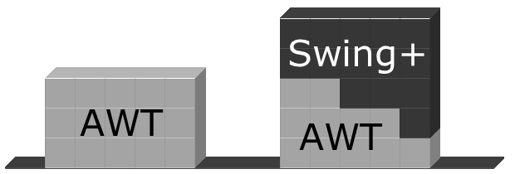
AWT and Swing

Slide 5
Creating a frame
import java.awt.*;
import java.awt.event.*;
import javax.swing.*;
public class ImageViewer
{
  private JFrame frame;
  /**
  * Create an ImageViewer show it on screen.
  */
  public ImageViewer()
  {
  makeFrame();
  }
  // rest of class omitted.
}

Slide 6
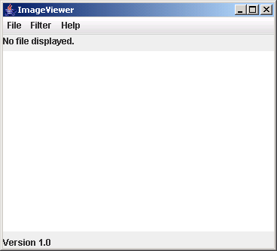
Elements of a frame
Title
Window controls
Menu bar
Content pane

Slide 7

The content pane
/**
* Create the Swing frame and its content.
*/
private void makeFrame()
{
frame = new JFrame("ImageViewer");
Container contentPane = frame.getContentPane();
JLabel label = new JLabel("I am a label.");
contentPane.add(label);
frame.pack();
frame.setVisible(true);
}
Notes:
Visa ver. 0-1

Slide 8
Adding menus
JMenuBar
  Displayed below the title.
  Contains the menus.
JMenu
  e.g. File. Contains the menu items.
JMenuItem
  e.g. Open. Individual items.

Slide 9
private void makeMenuBar(JFrame frame)
{
JMenuBar menubar = new JMenuBar();
frame.setJMenuBar(menubar);
// create the File menu
JMenu fileMenu = new JMenu("File");
menubar.add(fileMenu);
JMenuItem openItem = new JMenuItem("Open");
fileMenu.add(openItem);
JMenuItem quitItem = new JMenuItem("Quit");
fileMenu.add(quitItem);
}

Slide 10
Event handling
Events correspond to user interactions with components.
Components are associated with different event types.
  Frames are associated with WindowEvent.
  Menus are associated with ActionEvent.
Objects can be notified when an event occurs.
  Such objects are called listeners.

Slide 11
Centralized event receipt
A single object handles all events.
  Implements the ActionListener interface.
  Defines an actionPerformed method.
It registers as a listener with each component.
  item.addActionListener(this)
It has to work out which component has dispatched the event.
Notes:
import java.awt.event.*;

Slide 12
public class ImageViewer implements ActionListener
{
…
public void actionPerformed(ActionEvent e)
{
String command = e.getActionCommand();
if(command.equals("Open")) {
…
}
else if (command.equals("Quit")) {
…
}
…
}
…
private void makeMenuBar(Jframe frame)
{
…
openItem.addActionListener(this);
…
}
}
Notes:
Visa ver. 0-2

Slide 13
Centralized event handling
The approach works.
It is used, so you should be aware of it.
However …
  It does not scale well.
  Identifying components by their text is fragile.
An alternative approach is preferred.

Slide 14
Nested class syntax
Class definitions may be nested.
  public class Enclosing
  {
  …
  private class Inner
  {
  …
  }
  }

Slide 15
Inner classes
Instances of the inner class are localized within the enclosing class.
Instances of the inner class have access to the private members of the enclosing class.

Slide 16
Anonymous inner classes
Obey the rules of inner classes.
Used to create one-off objects for which a class name is not required.
Use a special syntax.
The instance is always referenced via its supertype, as it has no subtype name.

Slide 17
Anonymous action listener
JMenuItem openItem = new JMenuItem("Open");
openItem.addActionListener(new ActionListener() {
public void actionPerformed(ActionEvent e) {
openFile();
}
});

Slide 18
Anonymous class elements
Anonymous object creation
openItem.addActionListener(
  new ActionListener()
  {
  public void actionPerformed(ActionEvent e)
  {
  openFile();
  }
  }
);
Class definition
Actual parameter

Slide 19
Exit on window close
frame.addWindowListener(new WindowAdapter() {
public void windowClosing(WindowEvent e)
{
System.exit(0);
}
});
WindowAdapter provides a no-op implementation of the WindowListener interface.

Slide 20
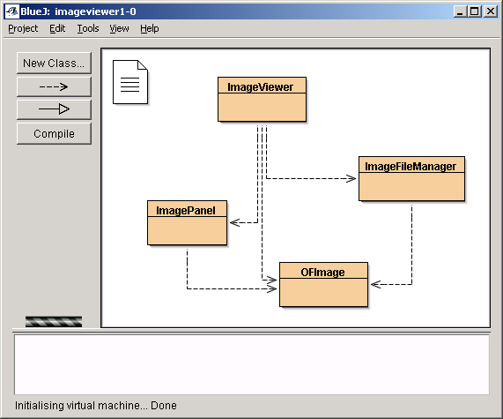
The imageviewer project

Slide 21
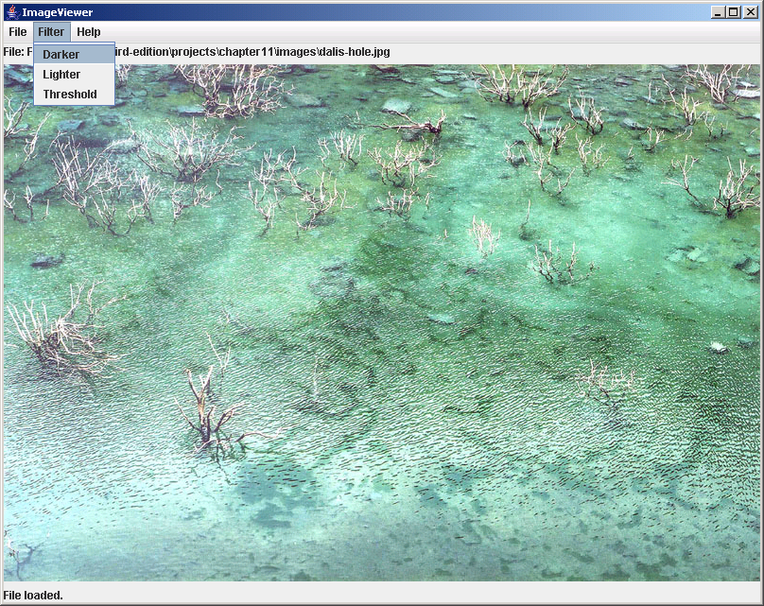
Image processing

Slide 22
Class responsibilities
ImageViewer
  Sets up the GUI structure.
ImageFileManager
  Static methods for image file loading and saving.
ImagePanel
  Displays the image within the GUI.
OFImage
  Models a 2D image.
Notes:
ImagePanel extends Component
OFImage extends BufferedImage
(se bild 24)

Slide 23
OFImage
Our subclass of BufferedImage.
Represents a 2D array of pixels.
Important methods:
  getPixel, setPixel
  getWidth, getHeight
Each pixel has a color.
  We use java.awt.Color.

Slide 24
Adding an ImagePanel
public class ImageViewer
{
private JFrame frame;
private ImagePanel imagePanel;
…
private void makeFrame()
{
Container contentPane = frame.getContentPane();
imagePanel = new ImagePanel();
contentPane.add(imagePanel);
}
…
}
Notes:
En ImagePanel är en Component som kan lagras i en Container.
(se bild 22)

Slide 25
Loading an image
public class ImageViewer
{
private JFrame frame;
private ImagePanel imagePanel;
…
private void openFile()
{
File selectedFile = …;
OFImage image =
ImageFileManager.loadImage(selectedFile);
imagePanel.setImage(image);
frame.pack();
}
…
}

Slide 26
Review
Aim for clean application structures.
  Keep GUI elements separate from application functionality!
Pre-defined components simplify creation of sophisticated GUIs.
Many components recognize user interactions with them.
Reactive components deliver events to listeners.
Notes:
Clean = Cohesive

